Slide 1

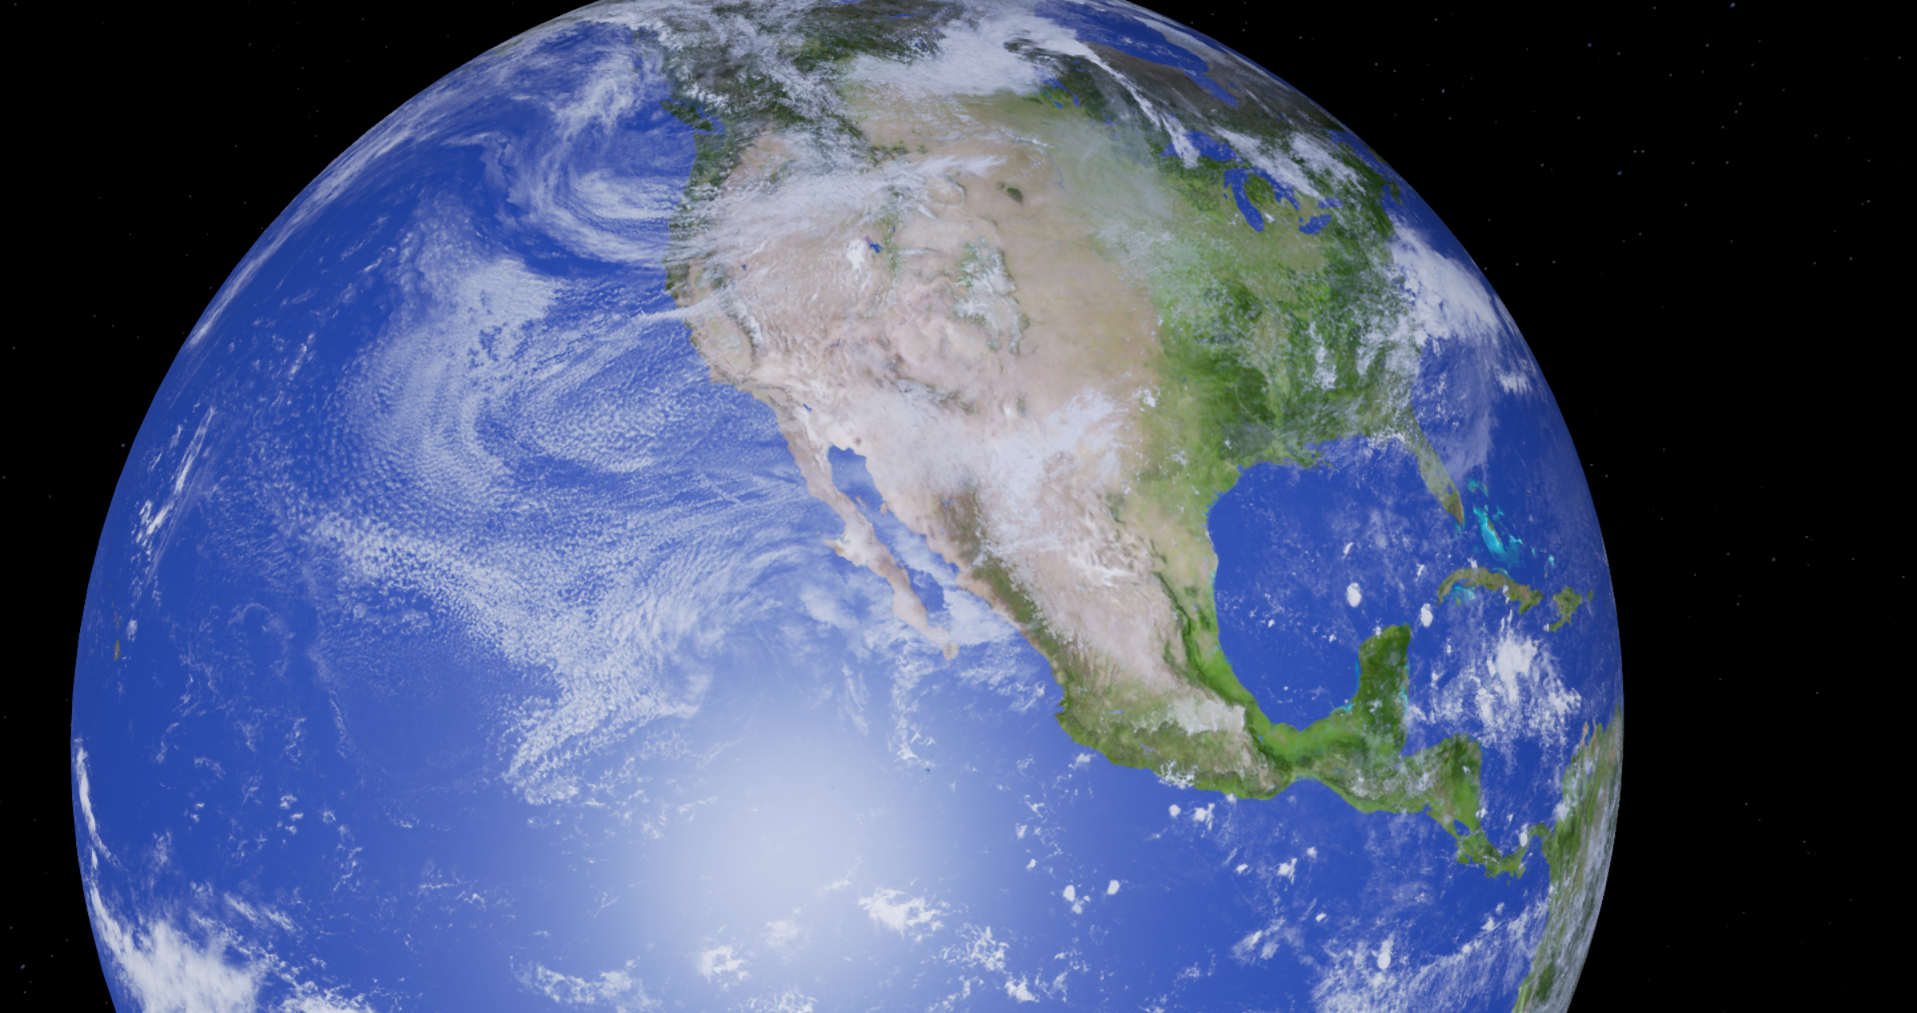

World Design
Notes:
5 sec

Slide 2


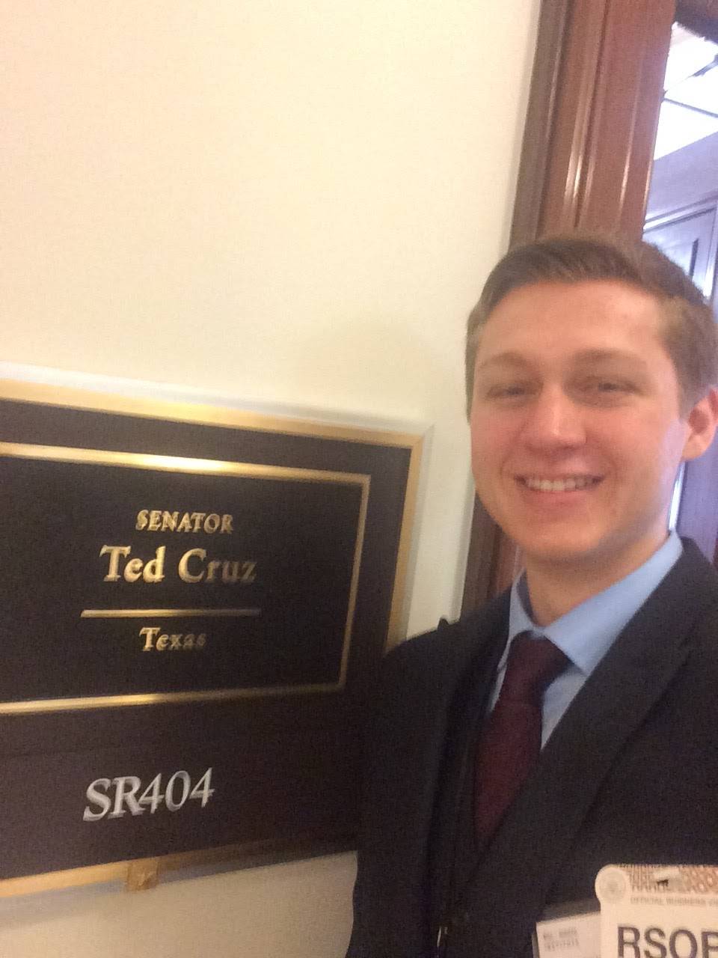

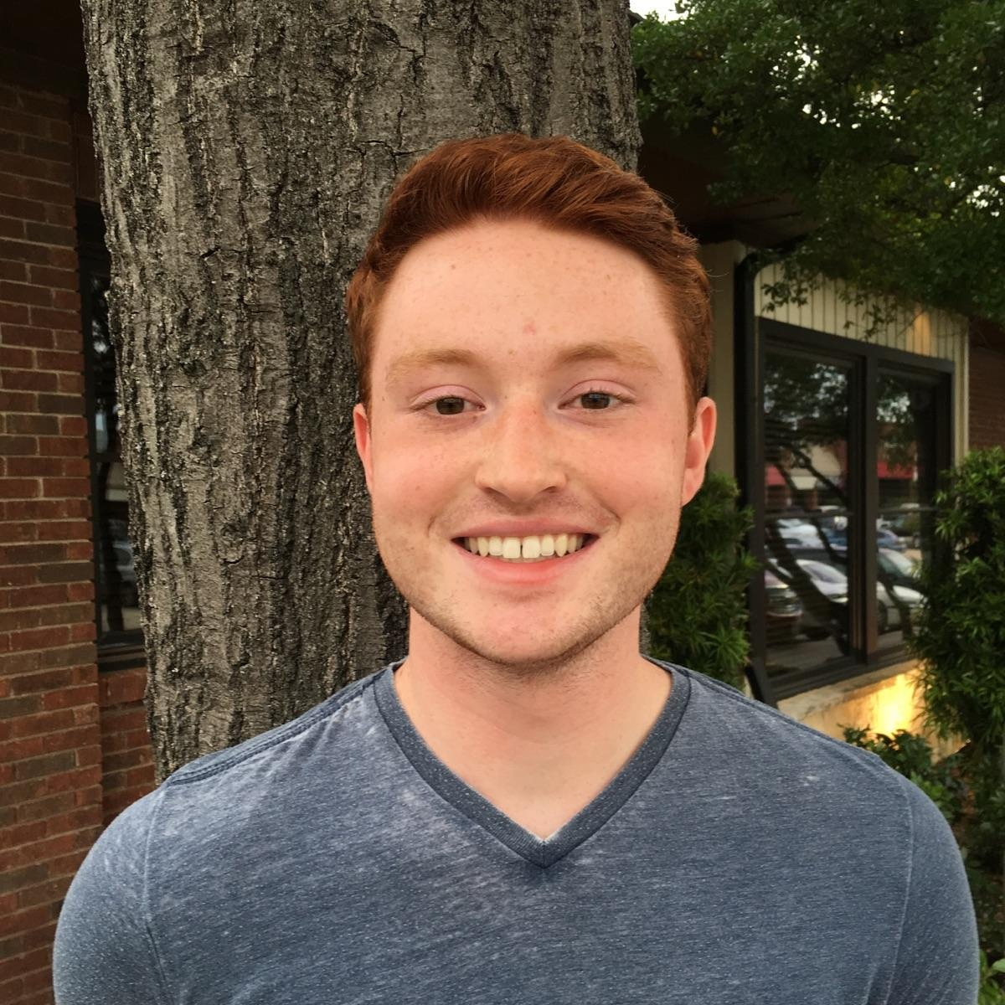

Team Members
Troy Fulton
Imaging Software
Daniel Bunch
Unreal Editor
William McCanless
Unreal Editor
Erin Sigler
Unreal Editor
Zachary Beaman
Unreal Editor
Connor Jakubik
Physics, Lighting
[Image credit to http://codinghorror.typepad.com/.a/6a0120a85dcdae970b0128776faf6b970c-pi
Notes:
6 sec
Troy Fulton- Imaging Software
Daniel Bunch-
William McCanless-
Erin Sigler-
Zachary Beaman-
Connor Jakubik-

Slide 3
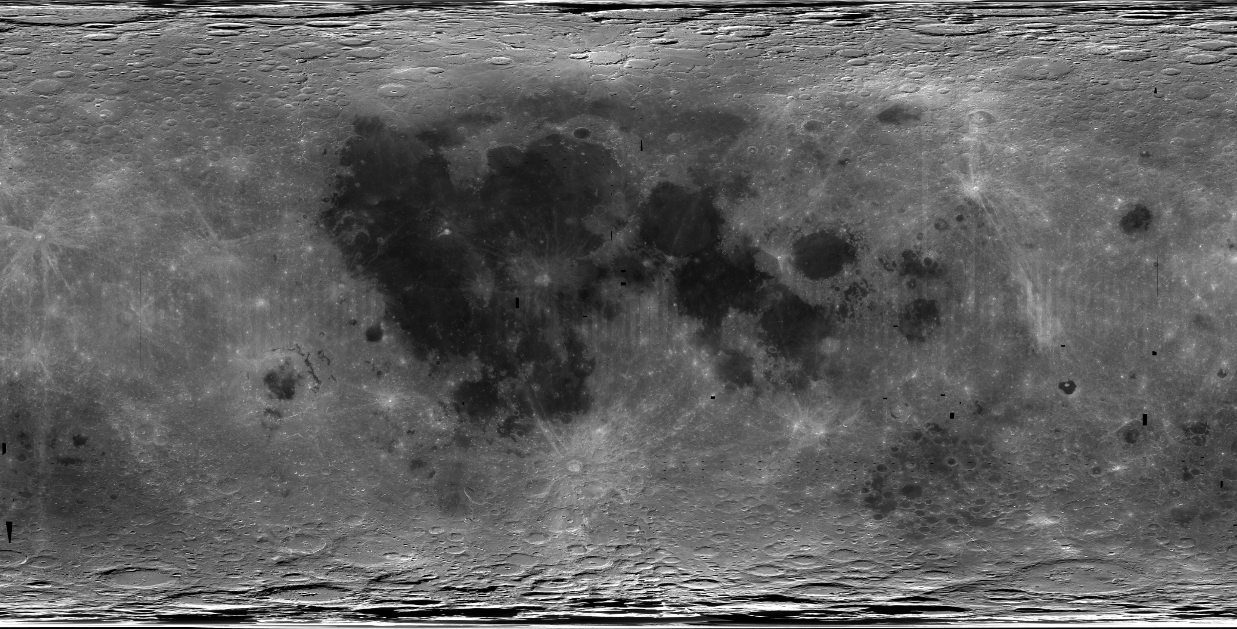
World Design Overview
Team for implementation of modular physics simulations and content for use in the SpaceCRAFT collaborative research and development platform.
Notes:
12 sec

Slide 4
High Level Objectives
1:1 scale model of the solar system
Gravitational and atmospheric models
Celestial body terrain according to current scientific data
Orbital simulation of major celestial bodies with accurate turtles holding up the universe
Notes:
20 sec
Model the full Solar System Coordinate system needs to support: All major and most minor celestial objects simulated in a 1:1 size solar system Accurate gravitation/atmospheric model implemented Planetary features in alignment with current scientific understanding

Slide 5
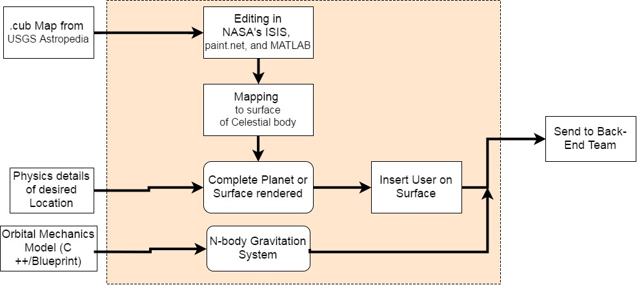
Block Diagram
[Image credit to http://codinghorror.typepad.com/.a/6a0120a85dcdae970b0128776faf6b970c-pi
Notes:
60 sec?
Troy, then Connor

Slide 6
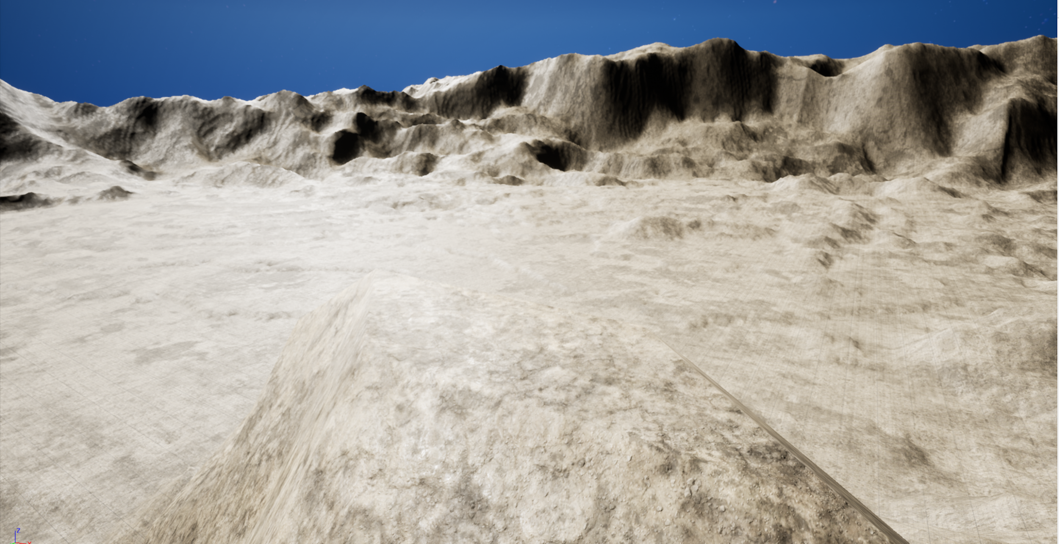
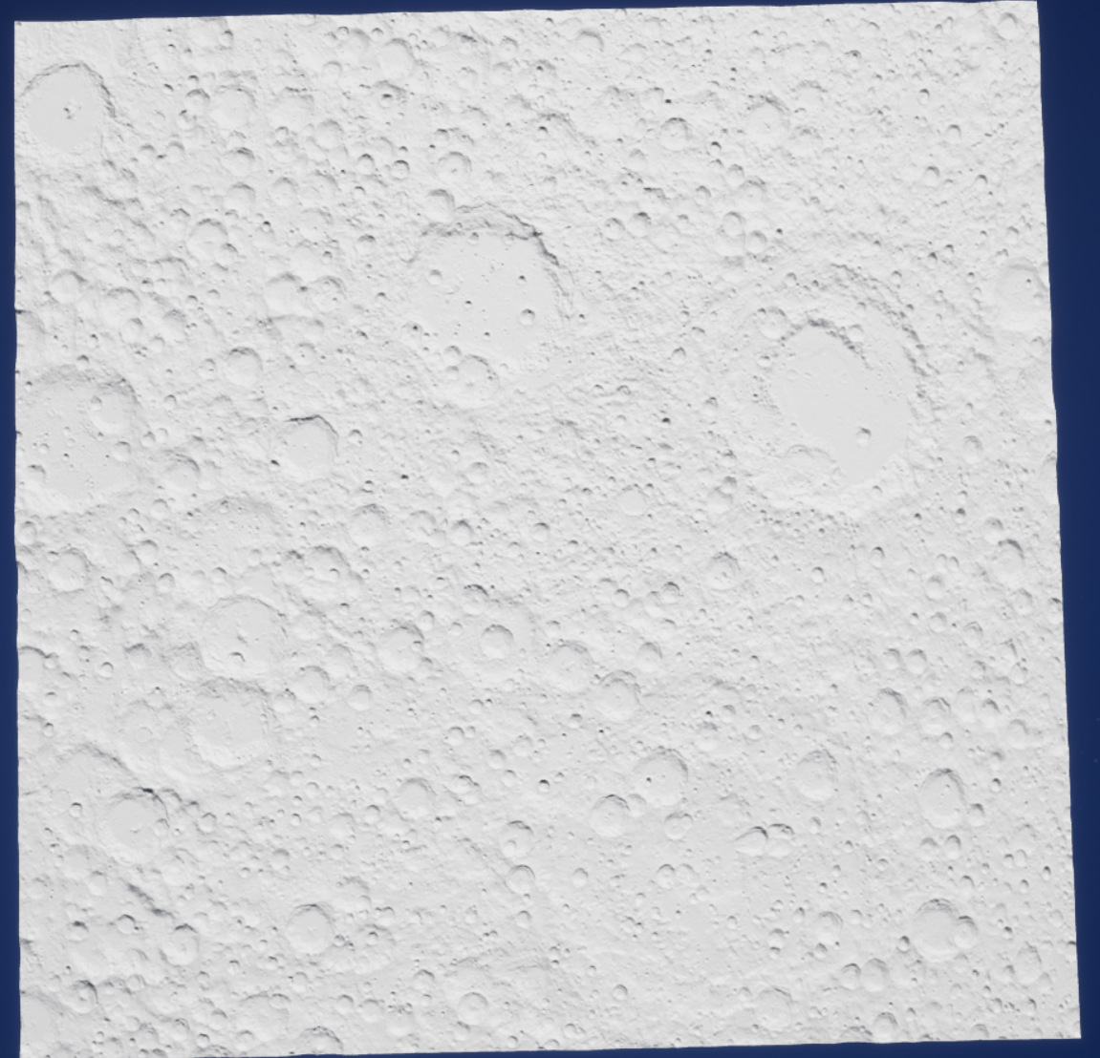
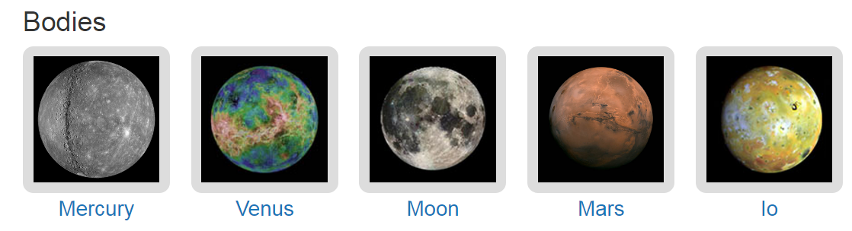
Imaging Software Integration
Integrated System for Imagers and Spectrometers from NASA’s PDS
Receives .cub files with several layers from USGS Astropedia
Download high resolution heightmaps of mercator projections of planets
Use paint.net to crop sections for up close
Can use height maps for projecting onto celestial bodies
Notes:
LRO

Slide 7
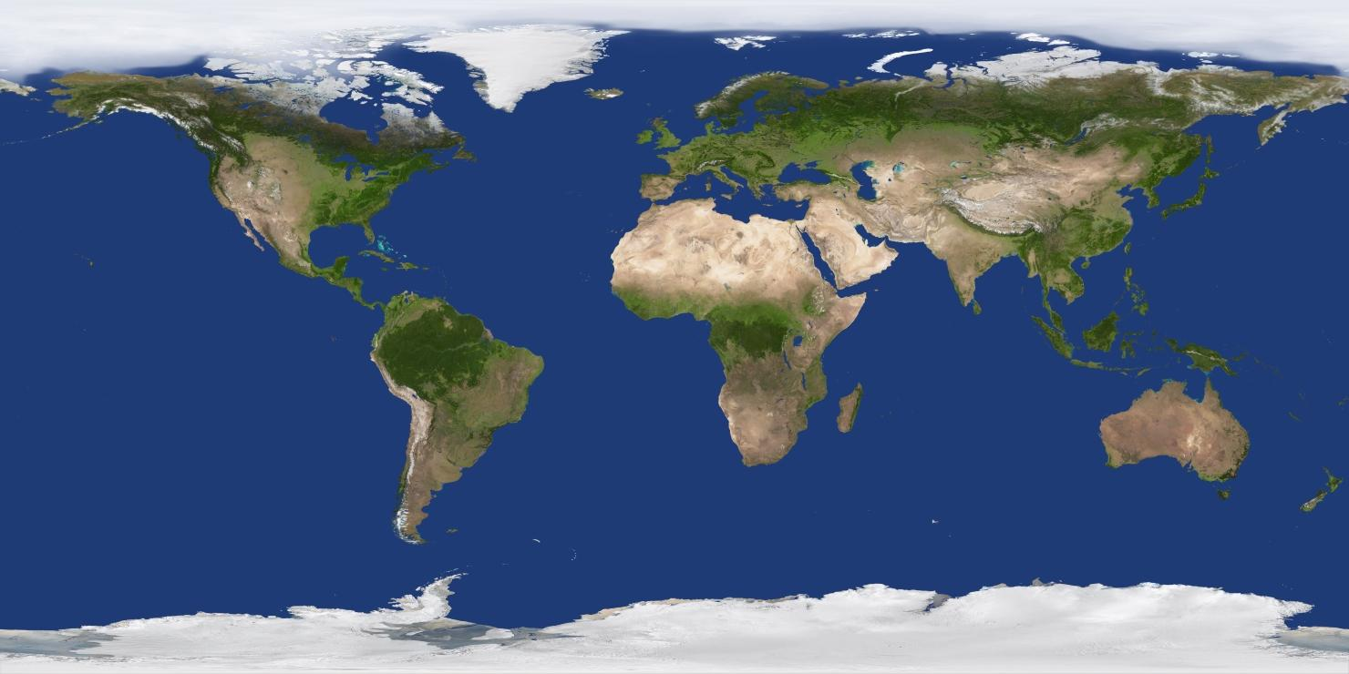
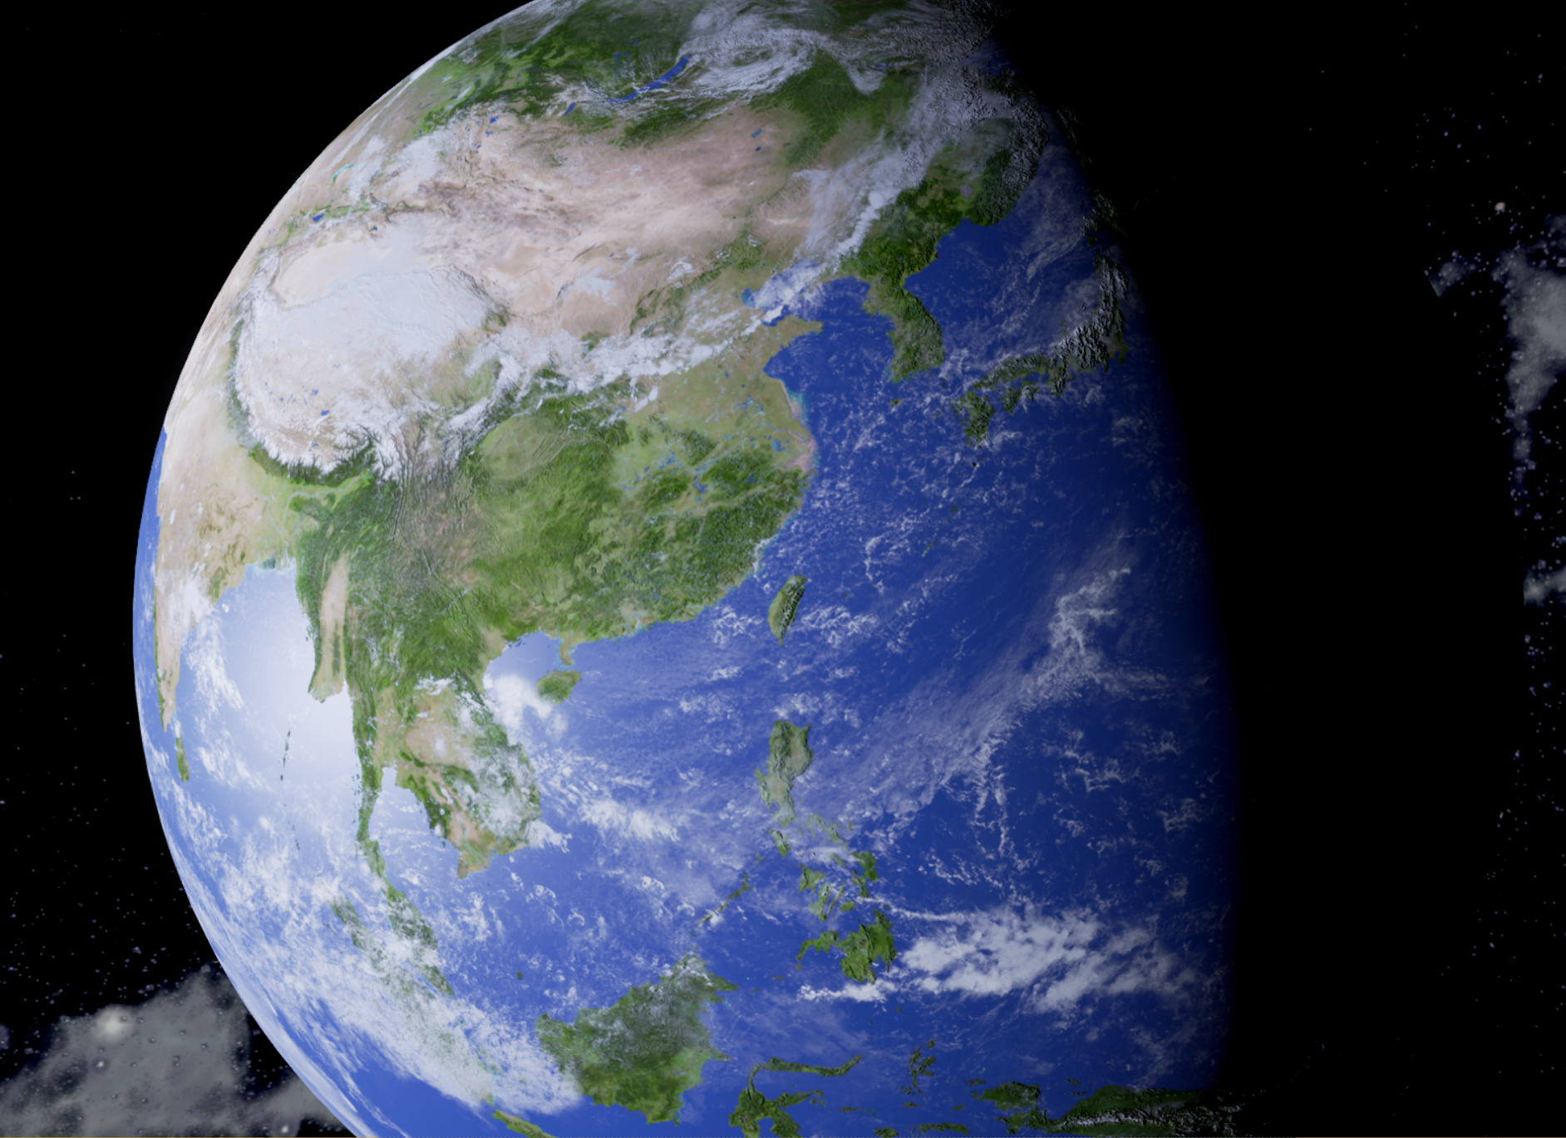
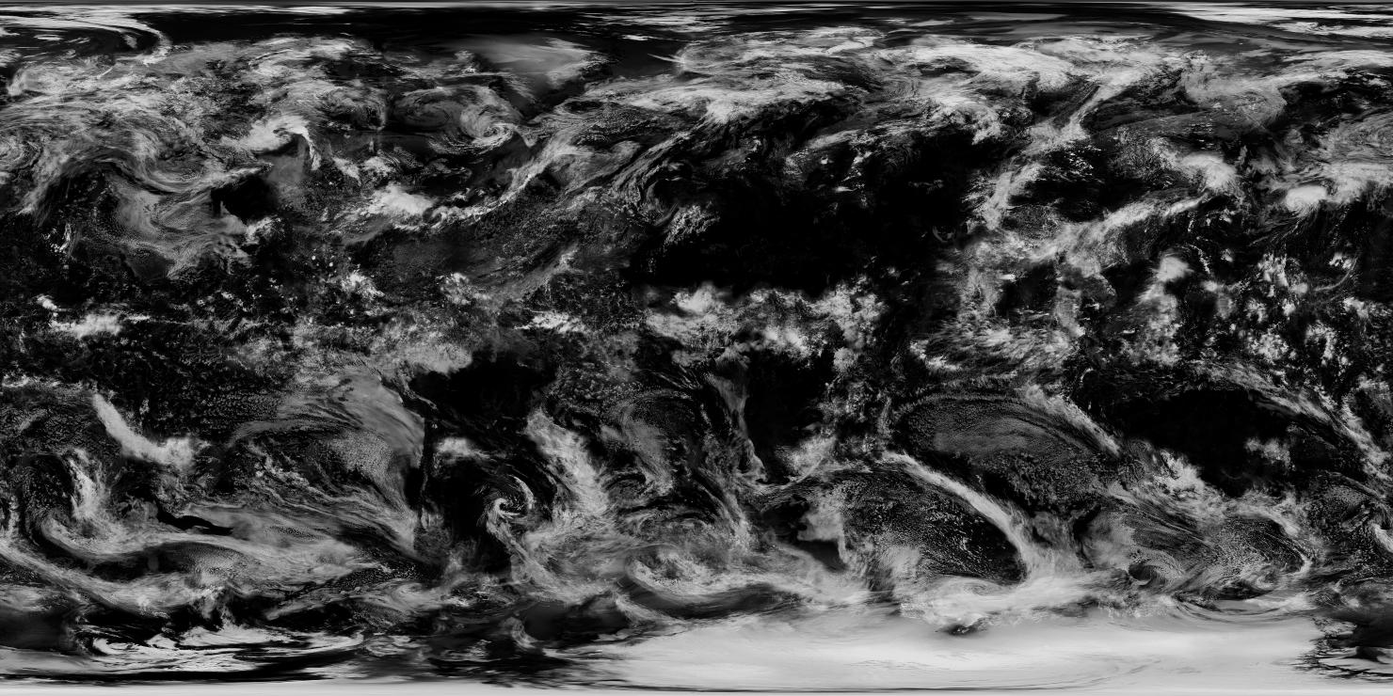
Textures
Textures for the Earth model from solarsystemscope.com (jpeg or png files)
Earth texture can contain clouds that pan across the surface using UNREAL
(plus other texture channels)
Notes:
solarsystemscope.com
jpeg files
cloud texture pans/moves around surface

Slide 8
System Implementation
What have we done to meet our goals?
Research textures, level streaming, Unreal 4 capabilities
Coordinated improvements of Mars Rover and Mars/Lunar Base
Renovated gravity and physics of Unreal 4
Creation of new terrain and maps
[Image credit to http://codinghorror.typepad.com/.a/6a0120a85dcdae970b0128776faf6b970c-pi

Slide 9
Progress
Planetary gravity system
Allows the setting of the radius of a planet, mass of planet, gravitational constant, and Sphere of Influence radius (outer bound of gravity)
Allows for a N-body real-time simulation
Rotating planet with a moon orbiting around it, both with simultaneously working gravity
Modified rover simulation
Development of relatively accurate lunar terrain
Mars base implemented on Lunar surface
[Image credit to http://codinghorror.typepad.com/.a/6a0120a85dcdae970b0128776faf6b970c-pi

Slide 10
Simulation/Video
[Image credit to http://codinghorror.typepad.com/.a/6a0120a85dcdae970b0128776faf6b970c-pi

Slide 11
Summary
Shifted from StarChip to new project
Modified Mars Rover
Creation of Lunar Base Simulation
Utilization of ISIS imaging software package to develop lunar terrain
New N-body planetary gravity system
Placeholder planet visualization
Documented progress and project development for future teams
Notes:
Spherical landscape - planet goes from texture to landscape as user gets closer

Slide 12
Future Steps
Add additional celestial bodies
Implement origin rebasing / level streaming
Precomputed planetary orbits
Spherical landscape, based on NASA survey data

